Slide 1
Form in HTML
Unit 5

Slide 2
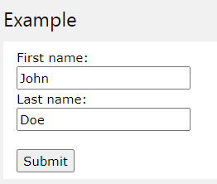
HTML FORMS
An HTML form is used to collect user input. The user input is most often sent to a server for processing.
HTML Forms are required, when you want to collect some data from the site visitor. For example, during user registration you would like to collect information such as name, email address, credit card, etc.
Sample Example:

Slide 3
The <form> Element
The HTML <form> element is used to create an HTML form for user input:
<form> form elements </form>
The <form> element is a container for different types of input elements, such as: text fields, checkboxes, radio buttons, submit buttons, etc.

Slide 4
The <input> Element
The HTML <input> element is the most used form element.
An <input> element can be displayed in many ways, depending on the type attribute.
Here are some examples:
Type | Description
<input type="text"> | Displays a single-line text input field
<input type="radio"> | Displays a radio button (for selecting one of many choices)
<input type="checkbox"> | Displays a checkbox (for selecting zero or more of many choices)
<input type="submit"> | Displays a submit button (for submitting the form)
<input type="button"> | Displays a clickable button

Slide 5
Text Fields
The <input type="text"> defines a single-line input field for text input.
Text Input Controls
There are three types of text input used on forms −
Single-line text input controls − This control is used for items that require only one line of user input, such as search boxes or names. They are created using HTML <input> tag.
Password input controls − This is also a single-line text input but it masks the character as soon as a user enters it. They are also created using HTMl <input> tag.
Multi-line text input controls − This is used when the user is required to give details that may be longer than a single sentence. Multi-line input controls are created using HTML <textarea> tag.

Slide 6

Single-line text input controls
This control is used for items that require only one line of user input, such as search boxes or names. They are created using HTML <input> tag.
<html>
<head>
<title>Text Input Control</title>
</head>
<body>
<form >
First name: <input type = "text" name = "first_name" />
<br>
Last name: <input type = "text" name = "last_name" />
</form>
</body>
</html>
This will produce the following result −

Slide 7
Attributes
Following is the list of attributes for <input> tag for creating text field.
Sr.No | Attribute & Description
1 | type Indicates the type of input control and for text input control it will be set to text.
2 | name Used to give a name to the control which is sent to the server to be recognized and get the value.
3 | value This can be used to provide an initial value inside the control.
4 | size Allows to specify the width of the text-input control in terms of characters.
5 | maxlength Allows to specify the maximum number of characters a user can enter into the text box.

Slide 8

Password input controls
This is also a single-line text input but it masks the character as soon as a user enters it. They are also created using HTML <input>tag but type attribute is set to password.
<html>
This will produce the following result −
<head>
<title>Password Input Control</title>
</head>
<body>
<form >
User ID : <input type = "text" name = "user_id" />
<br>
Password: <input type = "password" name = "password" />
</form>
</body>
</html>

Slide 9
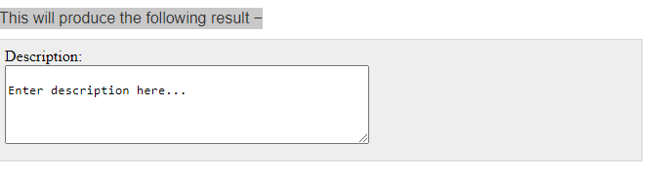
Multiple-Line Text Input Controls
This is used when the user is required to give details that may be longer than a single sentence. Multi-line input controls are created using HTML <textarea> tag.
<html>
<head>
<title>Multiple-Line Input Control</title>
</head>
<body>
<form>
Description : <br />
<textarea rows = "5" cols = "50" name = "description">
Enter description here...
</textarea>
</form>
</body>
</html>

Slide 10
Attributes
Sr.No | Attribute & Description
1 | name Used to give a name to the control which is sent to the server to be recognized and get the value.
2 | rows Indicates the number of rows of text area box.
3 | cols Indicates the number of columns of text area box

Slide 11
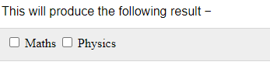
Checkbox Control
Checkboxes are used when more than one option is required to be selected. They are also created using HTML <input> tag but type attribute is set to checkbox..
<!DOCTYPE html>
<html>
<head>
<title>Checkbox Control</title>
</head>
<body>
<form>
<input type = "checkbox" name = "maths" value = "on"> Maths
<input type = "checkbox" name = "physics" value = "on"> Physics
</form>
</body>
</html>

Slide 12
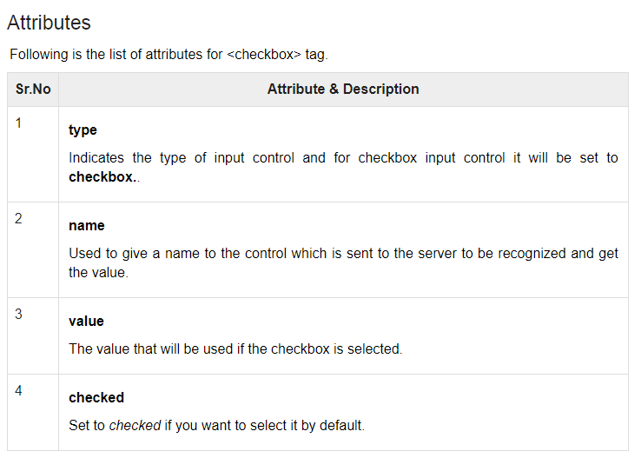

Slide 13
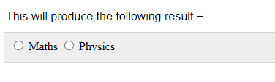
Radio Button Control
Radio buttons are used when out of many options, just one option is required to be selected. They are also created using HTML <input> tag but type attribute is set to radio.
<!DOCTYPE html>
<html>
<head>
<title>Radio Box Control</title>
</head>
<body>
<form>
<input type = "radio" name = "subject" value = "maths"> Maths
<input type = "radio" name = "subject" value = "physics"> Physics
</form>
</body>
</html>

Slide 14
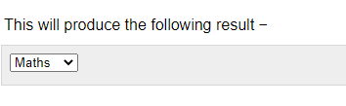
Select Box Control:
A select box, also called drop down box which provides option to list down various options in the form of drop down list, from where a user can select one or more options.
<!DOCTYPE html>
<html>
<head>
<title>Select Box Control</title>
</head>
<body>
<form>
<select name = "dropdown">
<option value = "Maths" selected>Maths</option>
<option value = "Physics">Physics</option>
</select>
</form>
</body>
</html>

Slide 15
Attributes
Following is the list of important attributes of <select> tag −
Sr.No | Attribute & Description
1 | name Used to give a name to the control which is sent to the server to be recognized and get the value.
2 | size This can be used to present a scrolling list box.
3 | multiple If set to "multiple" then allows a user to select multiple items from the menu.
is
Following the list of important attributes of <option> tag −
Sr.No | Attribute & Description
1 | value The value that will be used if an option in the select box box is selected.
2 | selected Specifies that this option should be the initially selected value when the page loads.

Slide 16
File Upload Box
If you want to allow a user to upload a file to your web site, you will need to use a file upload box, also known as a file select box. This is also created using the <input> element but type attribute is set to file.
<!DOCTYPE html>
<html>
<head>
<title>File Upload Box</title>
</head>
<body>
<form>
<input type = "file" name = "fileupload" accept = "image/*" />
</form>
</body>
</html>
Sr.No | Attribute & Description
1 | name Used to give a name to the control which is sent to the server to be recognized and get the value.
2 | accept Specifies the types of files that the server accepts.

Slide 17
Button Controls
There are various ways in HTML to create clickable buttons. You can also create a clickable button using <input>tag by setting its type attribute to button. The type attribute can take the following values −
Sr.No | Type & Description
1 | submit This creates a button that automatically submits a form.
2 | reset This creates a button that automatically resets form controls to their initial values.
3 | button This creates a button that is used to trigger a client-side script when the user clicks that button.
4 | image This creates a clickable button but we can use an image as background of the button.

Slide 18
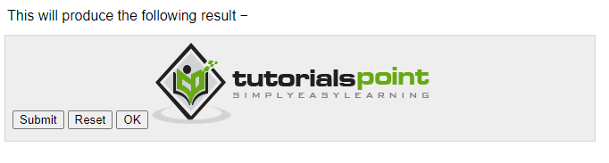
Example
<!DOCTYPE html>
<html>
<head>
<title>File Upload Box</title>
</head>
<body>
<form>
<input type = "submit" name = "submit" value = "Submit" />
<input type = "reset" name = "reset" value = "Reset" />
<input type = "button" name = "ok" value = "OK" />
<input type = "image" name = "imagebutton" src = "/html/images/logo.png" />
</form>
</body>
</html>

Slide 19
<fieldset> Tag
The <fieldset> tag is used to group related elements in a form.
The <fieldset> tag draws a box around the related elements.
<h1>The fieldset element</h1>
<form>
<fieldset>
<legend>Personalia:</legend>
First name:
<input type="text" name="fname"><br><br>
Last name:
<input type="text" name="lname"><br><br>
Email:
<input type="email" name="email"><br><br>
Birthday:
<input type="date" name="birthday"><br><br>
<input type="submit" value="Submit">
</fieldset>
</form>
The <legend> tag is used to define a caption for the <fieldset> element.

Slide 20
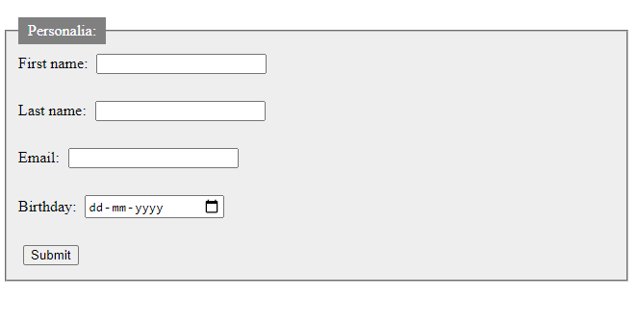
<fieldset> Tag
<form action="/action_page.php"> <fieldset>
<legend>Personalia:</legend>
<label for="fname">First name:</label> <input type="text" id="fname" name="fname"><br>
<label for="lname">Last name:</label> <input type="text" id="lname" name="lname"><br>
<label for="email">Email:</label> <input type="email" id="email" name="email"><br>
<label for="birthday">Birthday:</label> <input type="date" id="birthday" name="birthday"><br>
<input type="submit" value="Submit">
</fieldset>
</form>

Slide 21
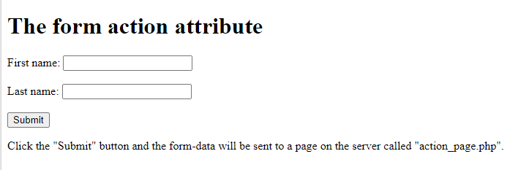
HTML <form> action Attribute
The HTML form action attribute defines where to send the form data when a form is submitted in an HTML document.
Syntax
<form action=“URL">
<!DOCTYPE html>
<html>
<body>
<h1>The form action attribute</h1>
<form action="/action_page.php">
<label for="fname">First name:</label>
<input type="text" id="fname" name="fname"><br><br>
<label for="lname">Last name:</label>
<input type="text" id="lname" name="lname"><br><br>
<input type="submit" value="Submit">
</form>
<p>Click the "Submit" button and the form-data will be sent to a page on the server called "action_page.php".</p>
</body></html>

Slide 22
<form> method Attribute
The method attribute specifies how to send form-data (the form-data is sent to the page specified in the action attribute).
The form-data can be sent as URL variables (with method="get") or as HTTP post transaction (with method="post").
Syntax:
<form method="get|post">
Value | Description
get | Default. Appends the form-data to the URL in name/value pairs: URL?name=value&name=value
post | Sends the form-data as an HTTP post transaction
Attribute Values

Slide 23
method="get"
<!DOCTYPE html>
<html>
<body>
<h1>The form method="get" attribute</h1>
<form action="/action_page.php" method="get“ target="_blank">
<label for="fname">First name:</label>
<input type="text" id="fname" name="fname"><br><br>
<label for="lname">Last name:</label>
<input type="text" id="lname" name="lname"><br><br>
<input type="submit" value="Submit">
</form>
<p>Click on the submit button, and the input will be sent to a page on the server called "action_page.php".</p>
</body>
</html>

Slide 24
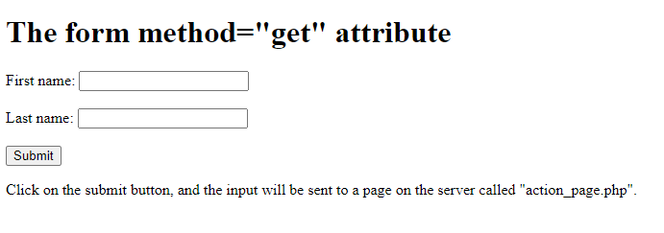
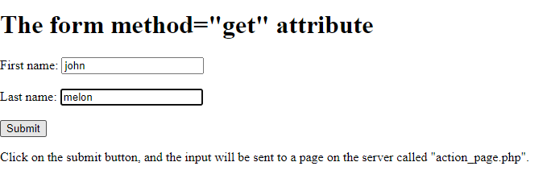
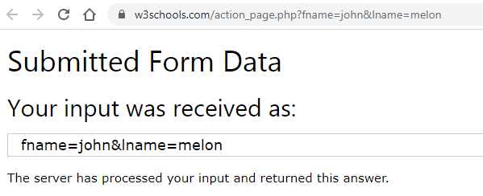

Slide 25
method=“post"
<!DOCTYPE html>
<html>
<body>
<h1>The form method=“post" attribute</h1>
<form action="/action_page.php" method="post" target="_blank">
<label for="fname">First name:</label>
<input type="text" id="fname" name="fname"><br><br>
<label for="lname">Last name:</label>
<input type="text" id="lname" name="lname"><br><br>
<input type="submit" value="Submit">
</form>
<p>Click on the submit button, and the input will be sent to a page on the server called "action_page.php".</p>
</body>
</html>

Slide 26
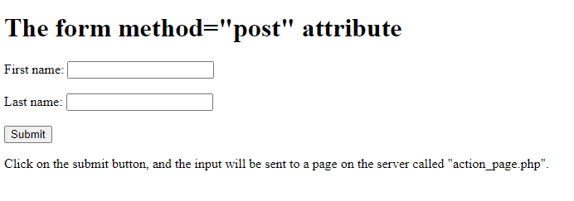
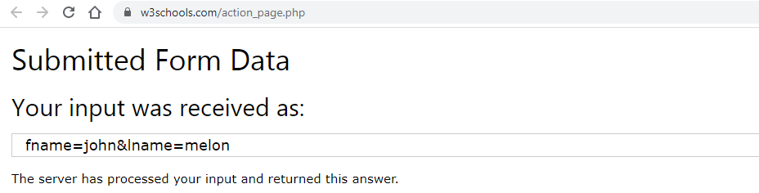

Slide 27
When to Use GET?
The default method when submitting form data is GET.
However, when GET is used, the submitted form data will be visible in the page address
field:/action_page.php?firstname=Mickey&lastname=Mouse

Slide 28
Get Method
Appends form-data into the URL in name/value pairs
The length of a URL is limited (about 3000 characters)
Never use GET to send sensitive data! (will be visible in the URL)
Useful for form submissions where a user wants to bookmark the result
GET is better for non-secure data, like query strings in Google

Slide 29
When to Use POST?
Always use POST if the form data contains sensitive or personal information. The POST method does not display the submitted form data in the page address field.
Notes on POST:
POST has no size limitations, and can be used to send large amounts of data.

Slide 30
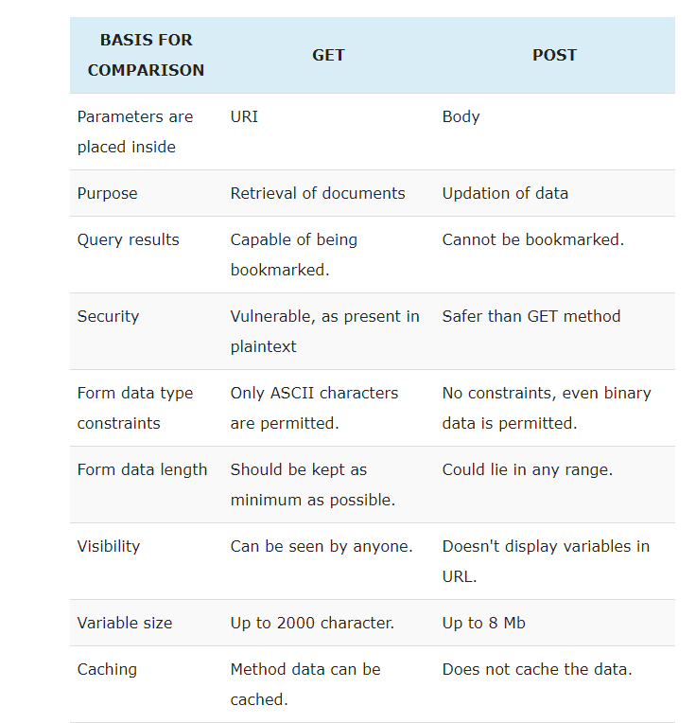

Slide 31
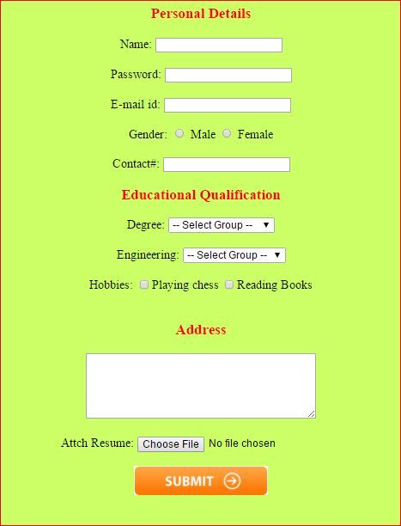

Slide 32
